Slide 1
OLAP
Need for Multidimensional Analysis.
Let us quickly review the business model of a large retail operation.
If you just look at daily sales, you soon realize that the sales are interrelated to many business dimensions.
The daily sales are meaningful only when they are related to the dates of the sales, the products, the distribution channels, the stores, the sales territories, the promotions, and a few more dimensions.
Multidimensional views are inherently representative of any business model. Very few models are limited to three dimensions or less.

Slide 2
For planning and making strategic decisions, managers and executives probe into business data through scenarios.
For example, they compare actual sales against targets and against sales in prior periods.
They examine the breakdown of sales by product, by store, by sales territory, by promotion, and so on

Slide 3
BUT
Decision makers are no longer satisfied with one-dimensional queries such as “How many units of Product A did we sell in the store in Ludhiana

Slide 4
Need for Multidimensional Analysis
How much revenue did the new Product X generate during the last three months, broken down by individual months, in the Ludhiana territory, by individual stores, broken down by promotions, compared to estimates, and compared to the previous version of the product?
The analysis does not stop with this single multidimensional query.
The user continues to ask for further comparisons to similar products, comparisons among territories, and views of the results by rotating the presentation between columns and rows.

Slide 5
For effective analysis, your users must have easy methods of performing complex analysis along several business dimensions.
They need an environment that presents a multidimensional view of data, providing the foundation for analytical processing through easy and flexible access to information

Slide 6
Decision makers must be able to analyze data along any number of dimensions, at any level of aggregation, with the capability of viewing results in a variety of ways.
They must have the ability to drill down and roll up along the hierarchies of every dimension.
Without a solid system for true multidimensional analysis, your data warehouse is incomplete.

Slide 7
In any analytical system, time is a critical dimension.
Hardly any query is executed without having time as one of the dimensions along which analysis is performed.
Further, time is a unique dimension because of its sequential nature—November always comes after October.
Users monitor performance over time, as for example, performance this month compared to last month, or performance this month compared with performance the same month last year.

Slide 8
Fast Access and Powerful Calculations
Whether a user’s request is for monthly sales of all products along all geographical regions or for year-to-date sales in a region for a single product, the query and analysis system must have consistent response times.
Users must not be penalized for the complexity of their analysis.
Both the size of the effort to formulate a query or the amount of time to receive the result sets must be consistent irrespective of the query types.

Slide 9
Imagine a business analyst looking for reasons why profitability dipped sharply in the recent months in the entire enterprise.
The analyst starts this analysis by querying for the overall sales for the last five months for the entire company, broken down by individual months.
The analyst notices that although the sales do not show a drop, there is a sharp reduction in profitability for the last three months

Slide 10
The analysis proceeds further when the analyst wants to find out which countries show reductions.
The analyst requests a breakdown of sales by major worldwide regions and notes that the European region is responsible for the reduction in profitability.
Now the analyst senses that clues are becoming more pronounced and looks for a breakdown of the European sales by individual countries.

Slide 11
Now the analyst wants the breakdown of profitability for the European countries by country, month, and product.
This step brings the analyst closer to the reason for the decline in the profitability.
The analyst observes that the countries in the European Union (EU) show very sharp declines in profitability for the last two months.
Further queries reveal that manufacturing and other direct costs remain at the usual levels but the indirect costs have shot up

Slide 12
The analyst formulates each query, executes it, waits for the result set to appear on the screen, and studies the result set.
Each query is interactive because the result set from one query forms the basis for the next query.
In this manner of querying, the user cannot maintain the train of thought unless the momentum is preserved.
Fast access is absolutely essential for an effective analytical processing environment.

Slide 13
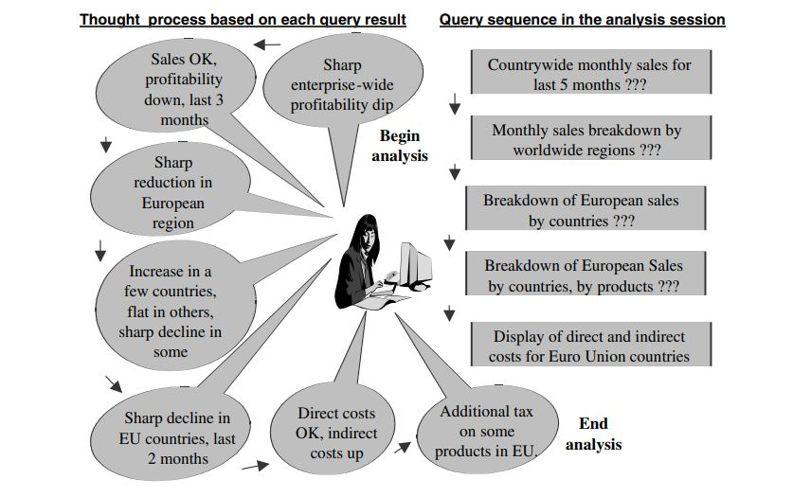

Slide 14
You now have a fairly good grip on the types of requirements of users to execute queries and perform analysis.
First and foremost, the information delivery system must be able to present multidimensional views of the data.
Then the information delivery system must enable the users to use the data by analyzing it along multiple dimensions and their hierarchies in a myriad of ways

Slide 15
First, let us look at the characteristics of the OLTP and data warehouse environments.
When we mention the data warehouse environment here, we are not referring to heavy multidimensional analysis and complex calculations.
We are only referring to the environment with simple queries and routine reports

Slide 16
Now consider information retrieval and manipulation in these two environments.
What are the standard methods of information delivery?
Reports, spreadsheets, and online displays.
What is the standard data access interface? SQL.

Slide 17
Report writers provide two key functions: the ability to point and click for generating and issuing SQL calls, and the capability to format the output reports.
However, report writers do not support multidimensionality.
With basic report writers, you cannot drill down to lower levels in the dimensions.
That will have to come from additional reports. You cannot rotate the results by switching rows and columns.
Once the report is formatted and run, you cannot alter the presentation of the result data sets

Slide 18
In a real-world analysis session, many queries follow one after the other.
Each query may translate into a number of intricate SQL statements, with each of the statements likely to invoke full table scans, multiple joins, aggregations, groupings, and sorting.
Analysis of the type we are discussing requires complex calculations and handling time series data. SQL is notably weak in these areas.

Slide 19
OLAP is the Answer
Users certainly need the ability to perform multidimensional analysis with complex calculations.
but we find that the traditional tools of report writers, query products, spreadsheets, and language interfaces are distressfully inadequate.
What is the answer?

Slide 20
We will thoroughly examine the various aspects of OLAP.
We will come up with formal definitions and detailed characteristics.
We will highlight all the features and functions.
We will explore the different OLAP models

Slide 21
Basic virtues of OLAP
Enables analysts, executives, and managers to gain useful insights from the presentation of data.
Can reorganize metrics along several dimensions and allow data to be viewed from different perspectives.
Supports multidimensional analysis.
Is capable of applying mathematical formulas and calculations to measures.
Provides fast response, facilitating speed-of-thought analysis.
Improves the comprehension of result sets through visual presentations using graphs and charts.
Can be implemented on the Web.

Slide 22
OLAP Definitions and Rules
We know that multidimensionality is at the core of OLAP systems.
On-Line Analytical Processing (OLAP) is a category of software technology that enables
Analysts, managers and executives to gain insight into data
Through fast, consistent, interactive access in a wide variety of possible views of information
That has been transformed from raw data to reflect the real dimensionality of the enterprise as understood by the user.

Slide 23
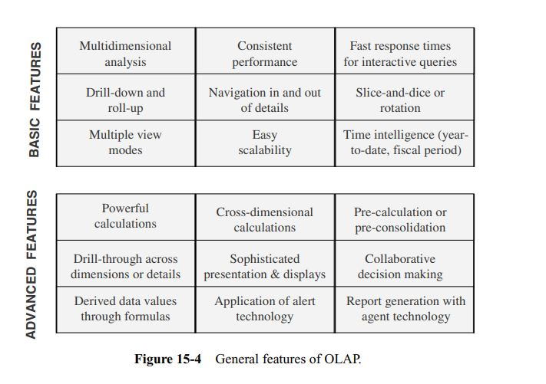
General Features of OLAP

Slide 24
STAR SCHEMA
Let us begin with a simple STAR schema. This STAR schema has three business dimensions, namely, product, time, and store.
The fact table contains sales.
in the STAR schema, time is one of the dimensions and month is one of the attributes of the time dimension.
Values of this attribute month are represented on the Y-axis.
Similarly, values of the attributes product name and store name are represented on the other two axes

Slide 25
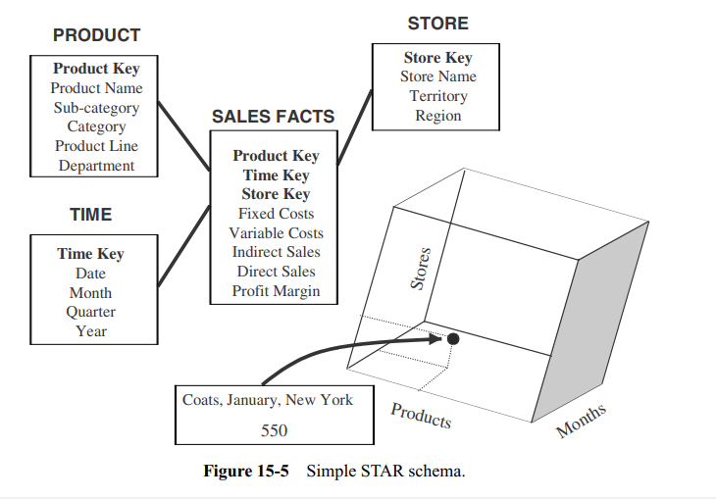

Slide 26
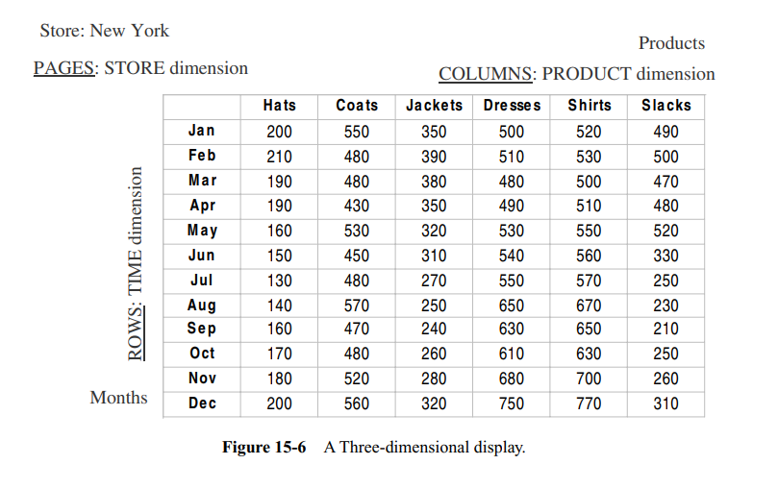

Slide 27
This schema with just three business dimensions does not even look like a star. Nevertheless, it is a dimensional model.
From the attributes of the dimension tables, pick the attribute product name from the product dimension, month from the time dimension, and store name from the store dimension

Slide 28
Now we have a way of depicting three business dimensions and a single fact on a two dimensional page and also on a three-dimensional cube.
The numbers in each cell on the page are the sale numbers.
What could be the types of multidimensional analysis on this particular set of data?
What types of queries could be run during the course of analysis sessions?
You could get sale numbers along the hierarchies of a combination of the three business dimensions of product, store, and time.

Slide 29
Sample of simple queries and the result sets during a multidimensional analysis session.
Query Display the total sales of all products for past five years in all stores.
Display of Results
Rows: Year numbers 2000, 1999, 1998, 1997, 1996
Columns: Total Sales for all products
Page: One store per page

Slide 30
DO YOURSELF
Query
Show comparison of total sales for all stores, product by product, between years 2000 and 1999 only for those products with reduced sales.

Slide 31
Display of Results
Rows: Year numbers 2000, 1999; difference; percentage decrease
Columns: One column per product, showing only the qualifying products
Page: All stores

Slide 32
OLAP MODELS
ROLAP stands for relational online analytical processing and MOLAP stands for multidimensional online analytical processing.
In either case, the information interface is still OLAP.
DOLAP stands for desktop online analytical processing.
DOLAP is meantto provide portability to users of online analytical processing.
In the DOLAP methodology, multidimensional datasets are created and transferred to the desktop machine, requiring only the DOLAP software to exist on that machine.
DOLAP is a variation of ROLAP.

Slide 33
In the MOLAP model, online analytical processing is best implemented by storing the data multidimensionally, that is, easily viewed in a multidimensional way.
Here the data structure is fixed so that the logic to process multidimensional analysis can be based on well-defined methods of establishing data storage coordinates.
Usually, multidimensional databases (MDDBs) are vendors’ proprietary systems.
On the other hand, the ROLAP model relies on the existing relational DBMS of the data warehouse.
OLAP features are provided against the relational database.

Slide 34
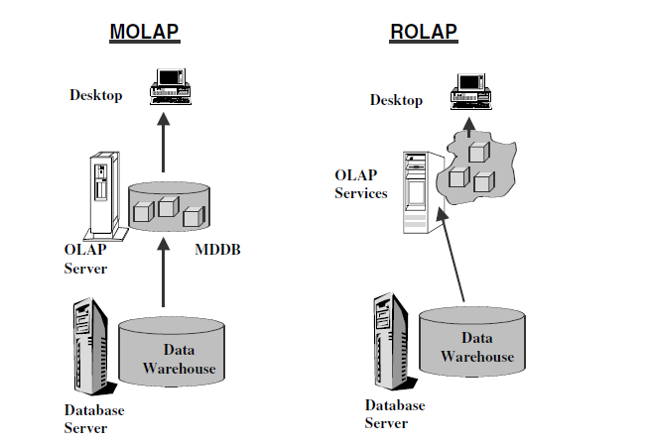
OLAP MODELS

Slide 35
Notice the MOLAP model shown on the left side of the figure.
The OLAP engine resides on a special server. Proprietary multidimensional databases (MDDBs) store data in the form of multidimensional hypercubes.
You have to run special extraction and aggregation jobs to create these multidimensional data cubes in the MDDBs from the relational database of the data warehouse.
The special server presents the data as OLAP cubes for processing by the users.

Slide 36
On the right side of the figure you see the ROLAP model.
The OLAP engine resides on the desktop.
Prefabricated multidimensional cubes are not created beforehand and stored in special databases.
The relational data is presented as virtual multidimensional data cubes.

Slide 37
The MOLAP Model
As discussed, in the MOLAP model, data for analysis is stored in specialized multidimensional
databases. Large multidimensional arrays form the storage structures.
For example, to store sales number of 500 units for product Product A, in month number 2001/01, in store StoreS1, under distributing channel Channel05, the sales number of 500 is stored inan array represented by the values (ProductA, 2001/01, StoreS1, Channel05).

Slide 38
The array values indicate the location of the cells. These cells are intersections of the
values of dimension attributes. If you note how the cells are formed, you will realize that
not all cells have values of metrics. If a store is closed on Sundays, then the cells representing
Sundays will all be nulls.

Slide 39
Precalculated and prefabricated multidimensional data cubes are stored in multidimensional databases.
The MOLAP engine in the application layer pushes a multidimensional view of the data from the MDDBs to the users.
As mentioned earlier, multidimensional database management systems are proprietarysoftware systems.
These systems provide the capability to consolidate and fabricate summarizedcubes during the process that loads data into the MDDBs from the main data
warehouse.
The users who need summarized data enjoy fast response times from the preconsolidated data.

Slide 40
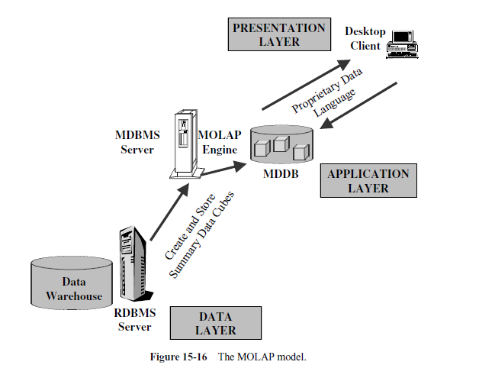

Slide 41
The ROLAP Model
In the ROLAP model, data is stored as rows and columns in relational form.
This model presents data to the users in the form of business dimensions.
In order to hide the storage structure to the user and present data multidimensionally, a semantic layer of metadata is created.
The metadata layer supports the mapping of dimensions to the relational tables.
Additional metadata supports summarizations and aggregations.
You may store the metadata in relational databases.

Slide 42
figure shows the architecture of the ROLAP model. What
you see is a three-tier architecture. The analytical server in the middle tier application layer
creates multidimensional views on the fly. The multidimensional system at the presentation
layer provides a multidimensional view of the data to the users. When the users issue
complex queries based on this multidimensional view, the queries are transformed
into complex SQL directed to the relational database. Unlike the MOLAP model, static
multidimensional structures are not created and stored.

Slide 43
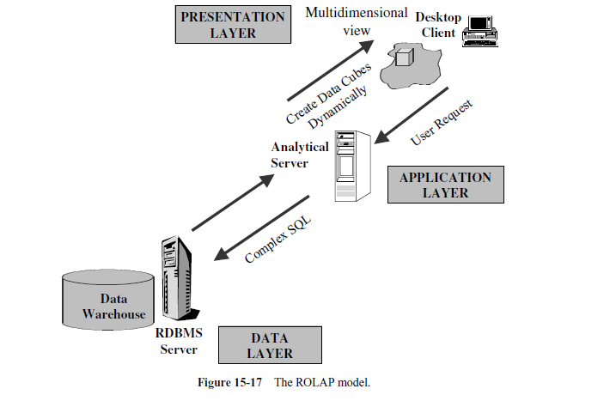

Slide 44
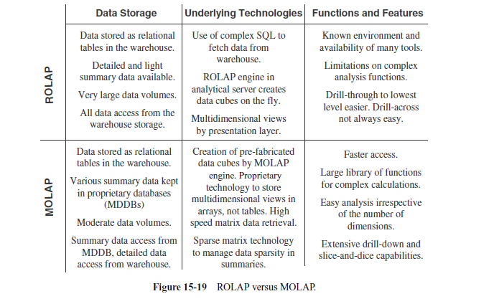

Slide 45
END OF CHAPTER

